Slide 1
AngularJS
Introduction

Slide 2
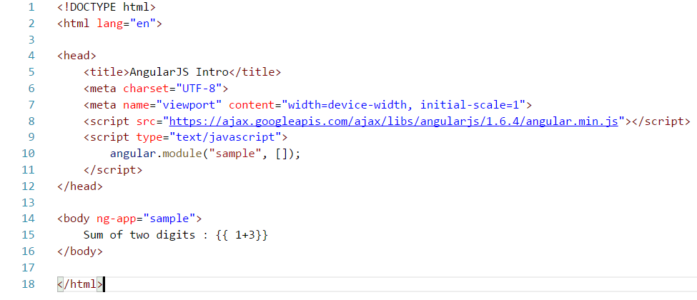
Make AngularJS available to Web Page
Step to make available and test Angular JS on a Web page :
Download/refer(CDN) “angular-version-x.js” on your page
Define an angular module using “angular.module”
Define the angular root directive “ng-app”
Write the angular code inside the root directive <body ng-app=“sample”>…….</body>

Slide 3
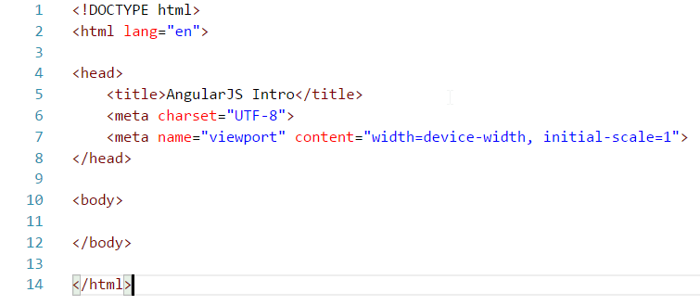
Step 1 : Create an empty html page

Slide 4
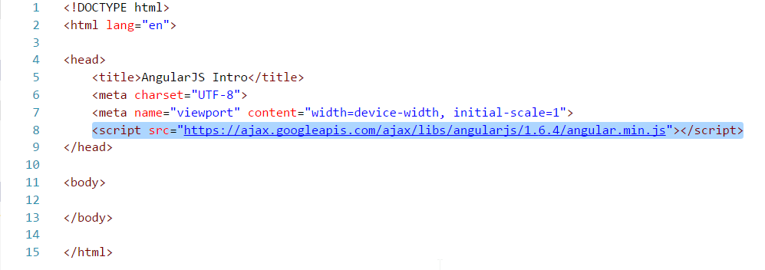
Step 2 : Include angularjs.js into your page using CDN(https://angularjs.org/)

Slide 5
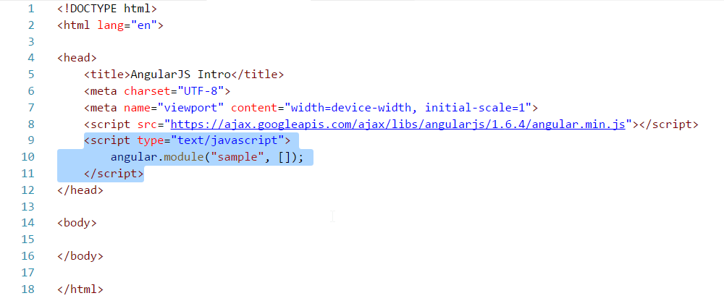
Step 3 : Create a module (ex:“sample”) for the page
Create an angular module with a name
Angular module : all application logic under one umbrella
If second parameter is provided(ie, []), we are creating a new module
Empty square brackets means , the module has not dependencies (on other modules)

Slide 6
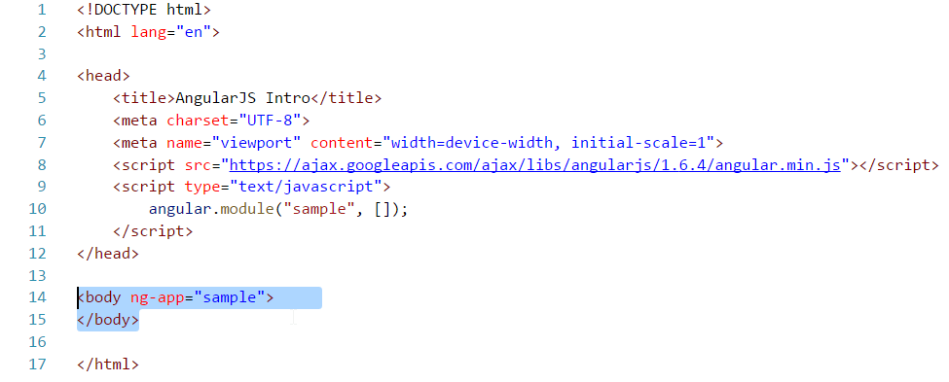
Step 4 : Decorate an element using “ng-app” and attach to the module,
Ex : adding the “ng-app” into <body> tag
Decorate an element with “ng-app”
ng-app = Angular Application
It is the root where Angular starts applying its “magic”
Can be attached to any HTML element(but, usually to BODY or HTML tags)
ng-app is associated to an angular module, called “root module”
Usually one “app-app” per web page
Multiple “ng-app” on same web page is still possible
“ng-app” cannot be nested.

Slide 7
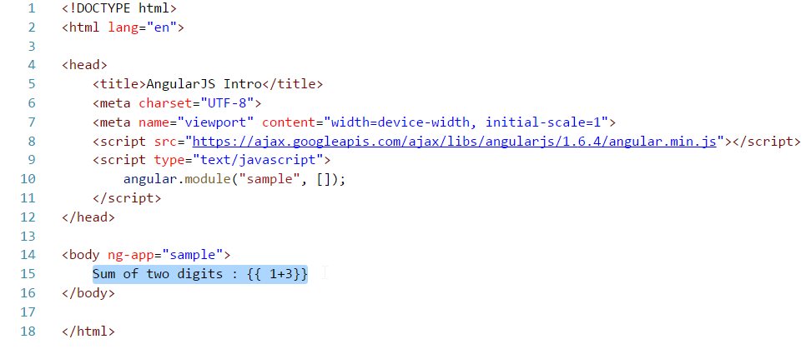
Step 5 : Add the angular expression to test the page {{1+3}}
{{<exp>}}
Angular Expression
Javascript-like code snippets, evaluated by Angular
Control flow statements (conditional statements, loops etc) are NOT allowed

Slide 8
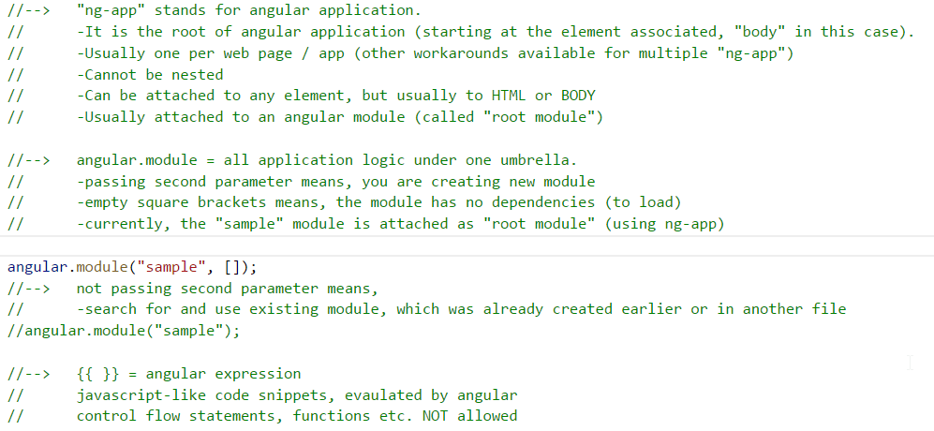
Explanation :

